Slide 1
Unit 5
Competitions
Global Travel & Tourism Partnership

Slide 2
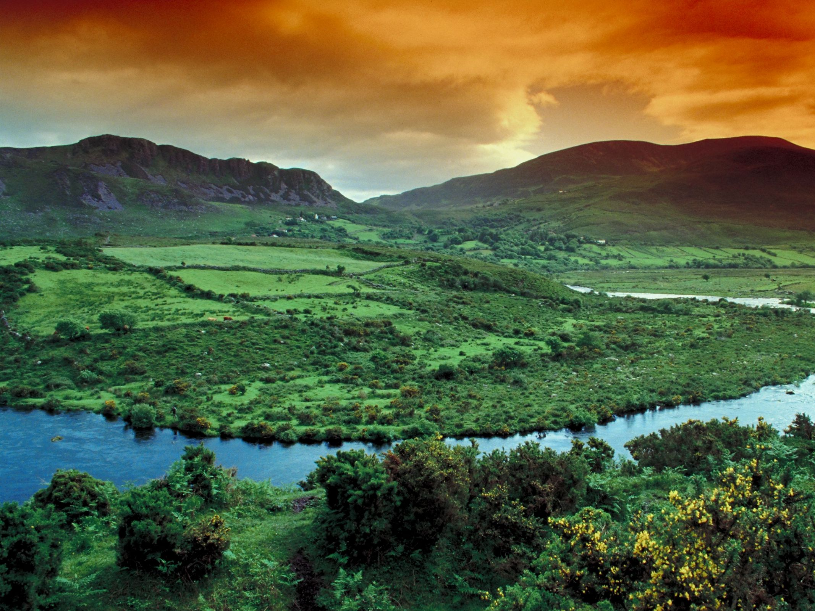
GTTP – What is it
The Global Travel & Tourism Partnership (GTTP), is an international initiative to inspire and enable young people to build careers in Travel & Tourism.
Click here to watch a short introductory video.
Notes:
https://youtu.be/Brv6CctVeq4

Slide 3
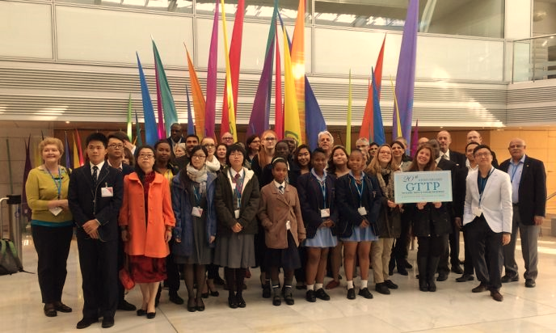
GTTP COMPETITIONS
GTTP has five competitions:
A Travel Photo contest, (Individual)
A Travel Writing contest, (Individual)
A Research competition, (Group)
A Sustainability Competition NEW 2017, (Group)
A Student-of-the-Year competition. - Nomination

Slide 4
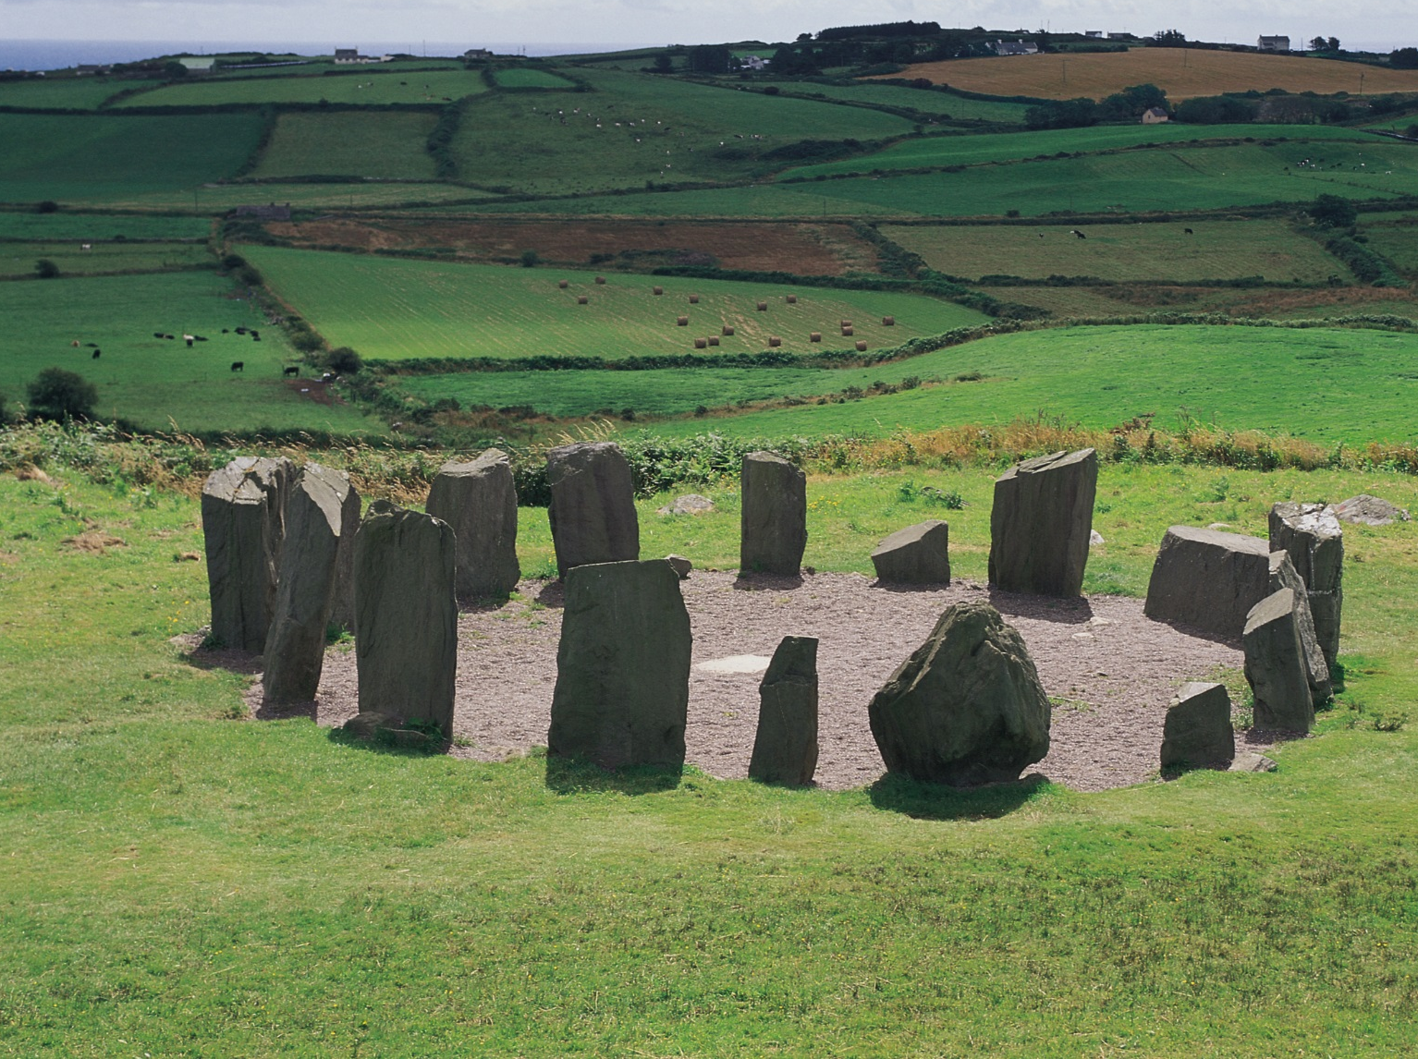
GTTP Travel Photo Competition: “See Something Special”
The purpose of the photo competition is to develop your communication skills using visual tools.
The goal of the Digital Photo competition is to show a special aspect of a student’s community to people who have never been there.
The photo should make the viewer want to come visit.
Photographs could be of a historic building; a natural feature, such as a lake or mountain; an event, such as a procession; a local specialty, such as food; an activity or sport; a person or a group of people.
For details and entry forms, Click Here.
To see past winners Click Here.

Slide 5
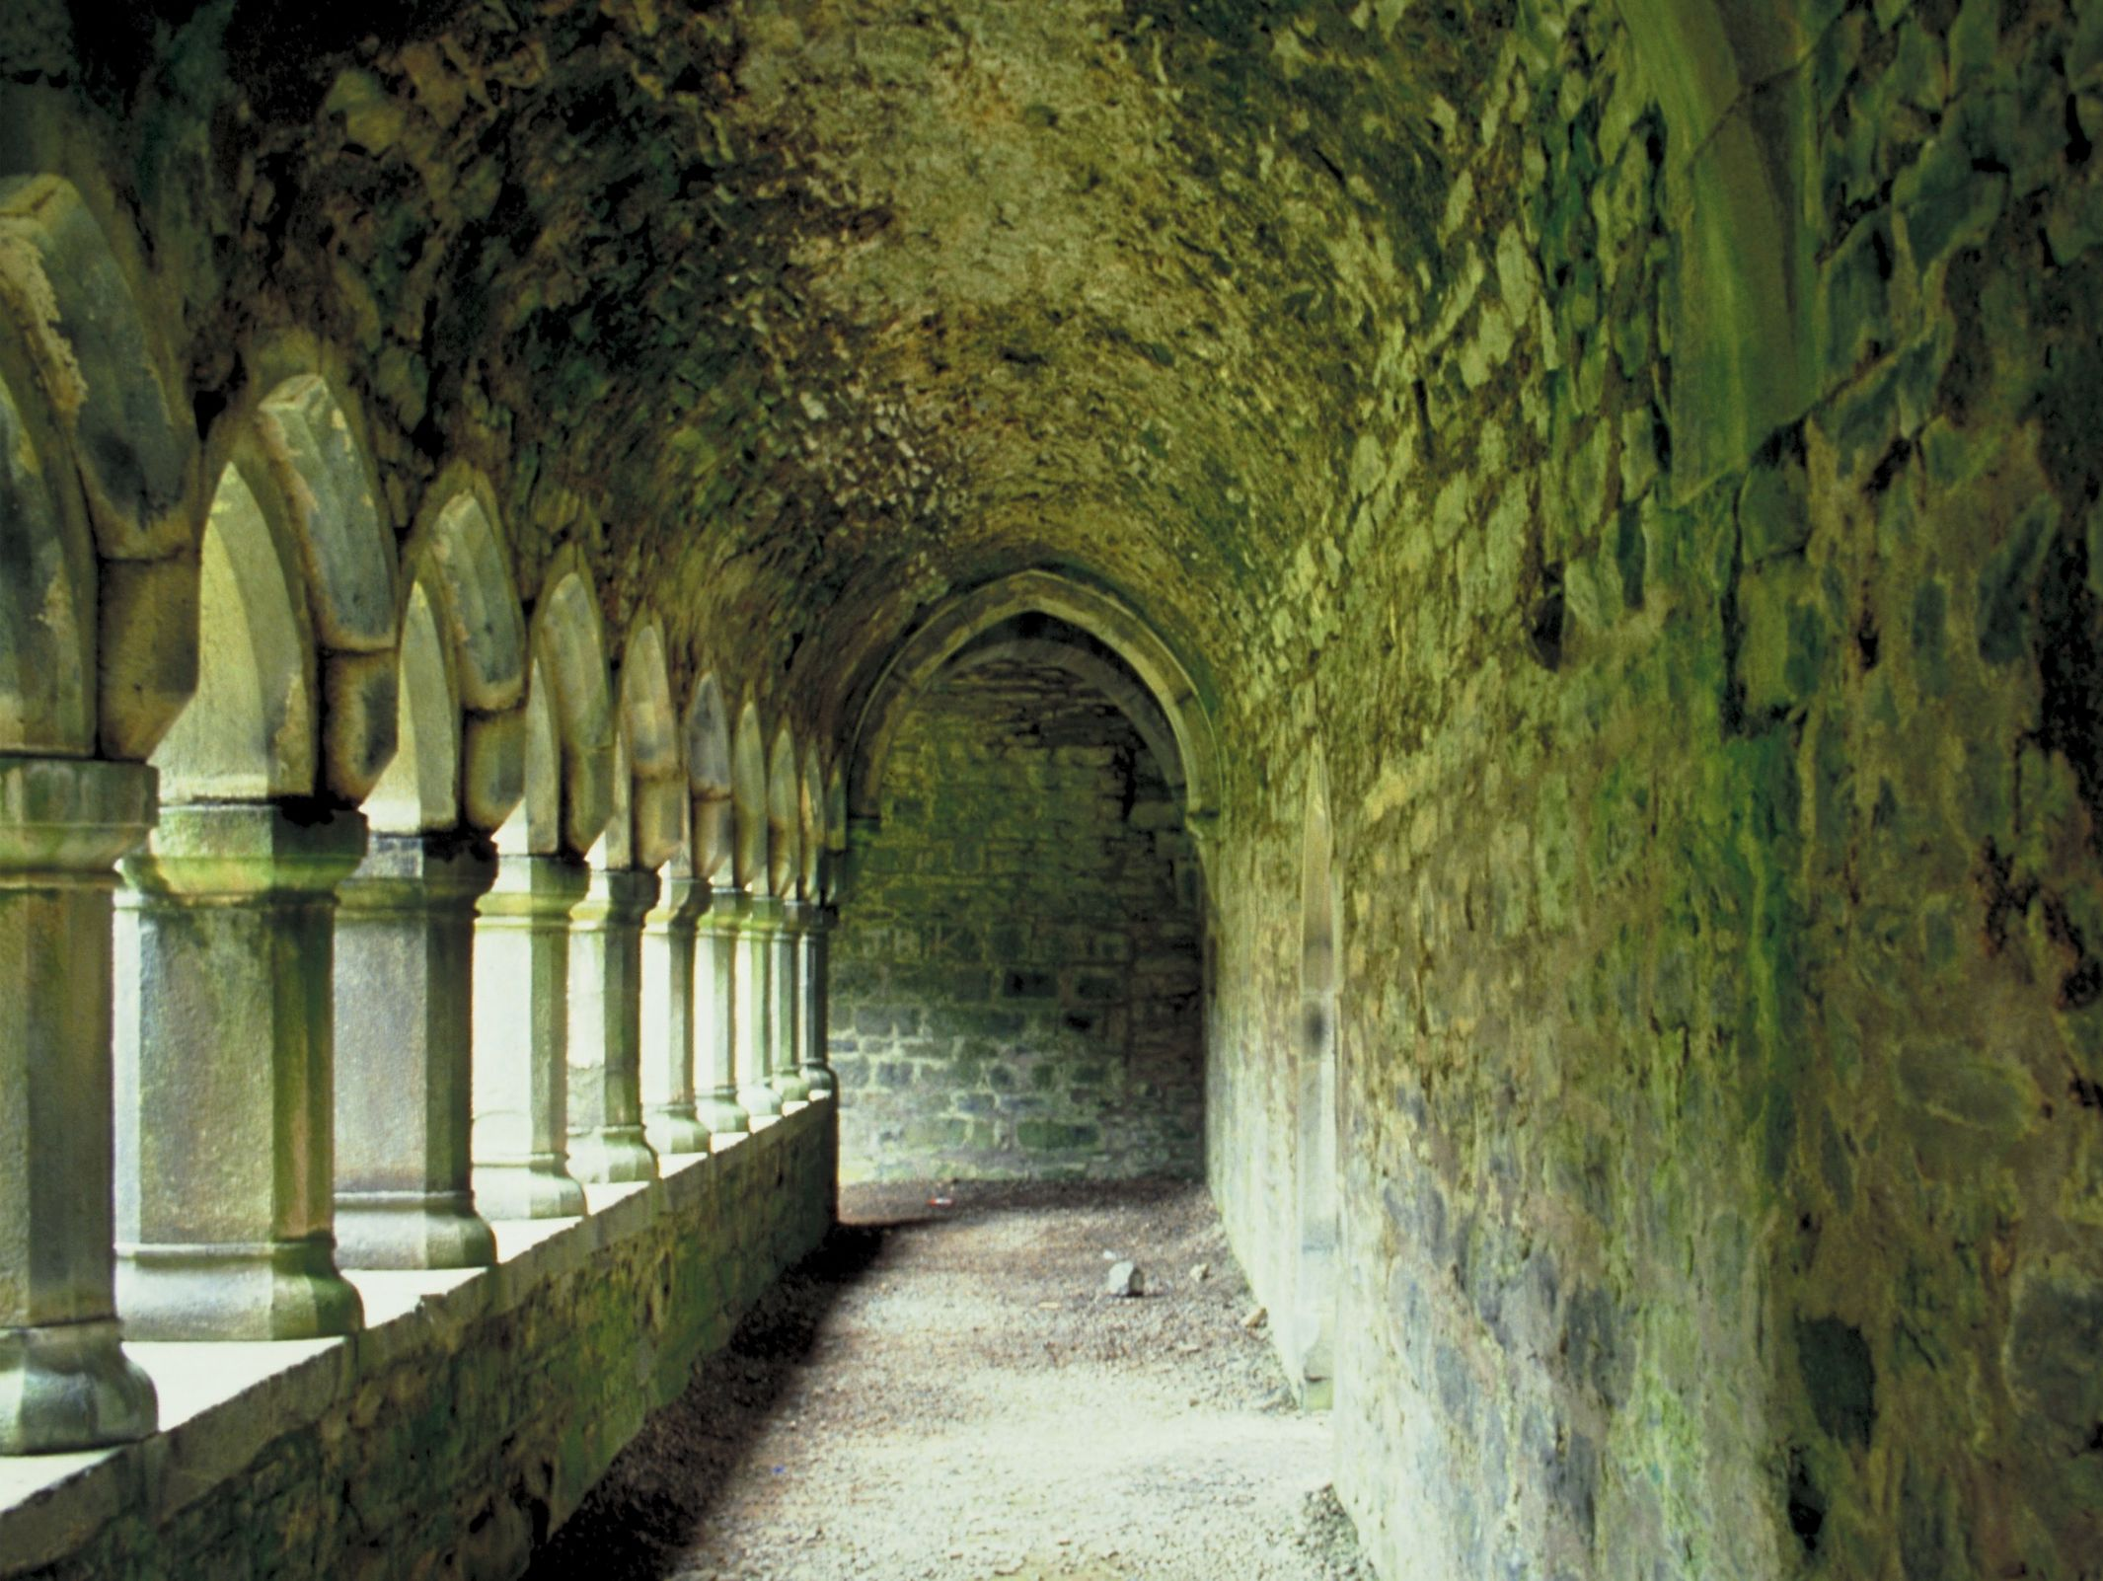
GTTP Travel Writing Competition: “Visit a Special Place”
The essay competition reinforces the GTTP’s emphasis on encouraging research and communications skills of young people we hope to attract to our industry.
The theme of the essay competition is “Discover My Country,” and it offers an opportunity for students to think about what visitors might find interesting in their communities.
For details, Click Here.
For guidelines and application forms Click Here.

Slide 6
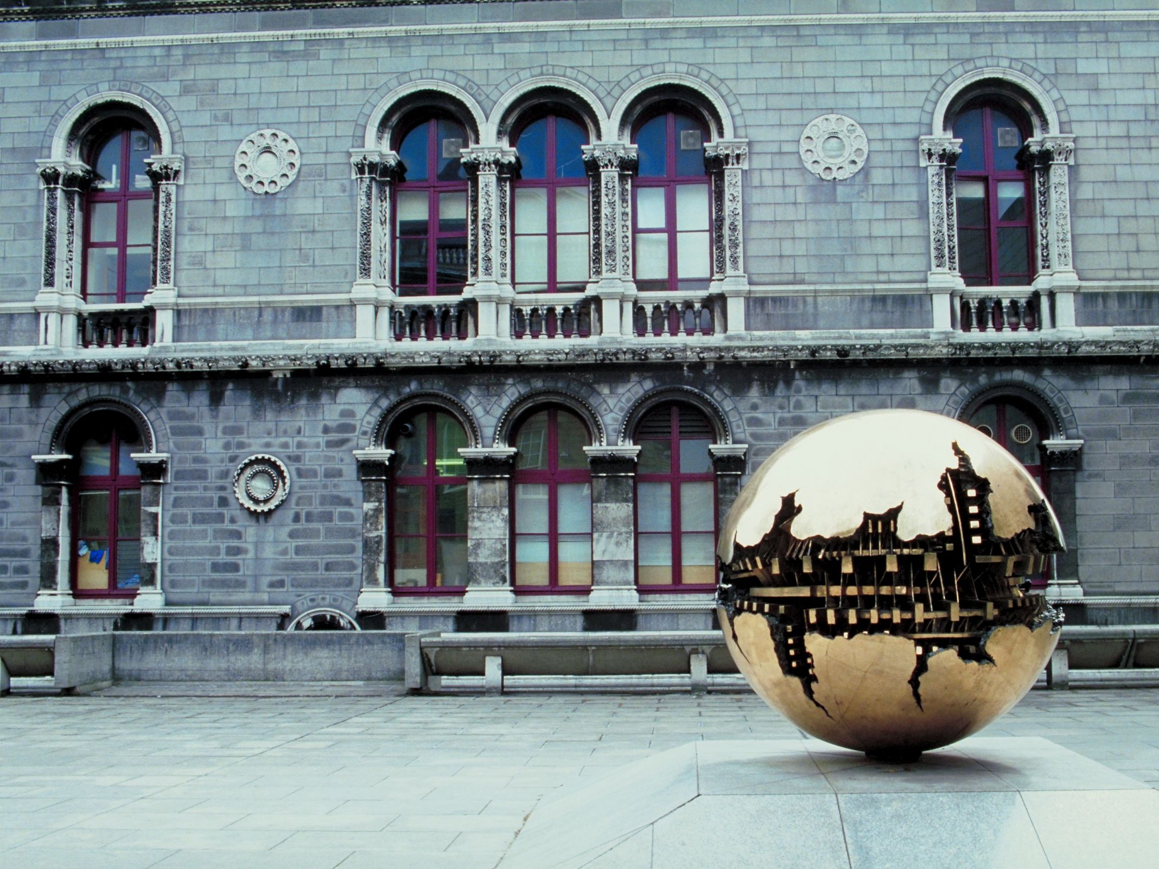
GTTP Research Competition – A Team Effort
This competition requires student teams to research a Travel & Tourism opportunity or issue in their local or national context.
The winning school in each country sends a team to the GTTP International Student-Teacher Conference held each November in Nice, France.
This competition is sponsored by the GTTP’s Global Partners and the Aldo Papone Endowment.

Slide 7
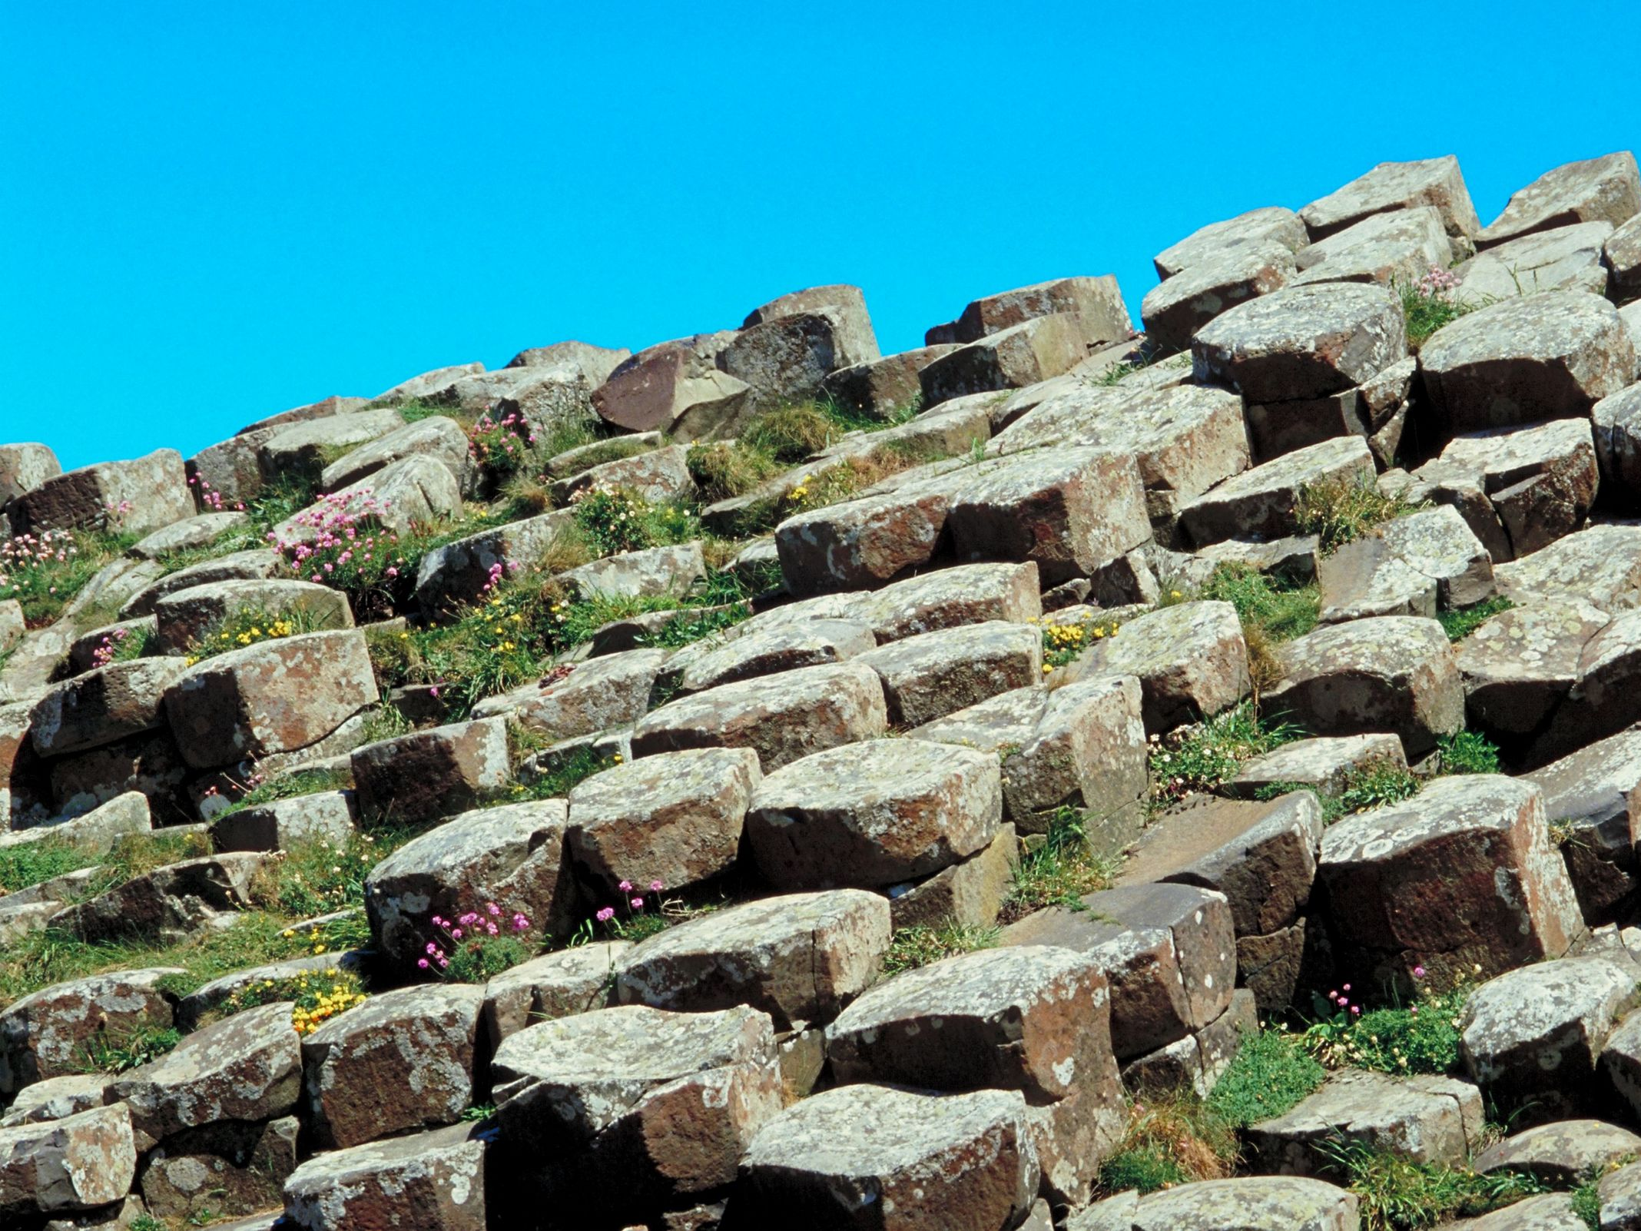
How The Research Competition Works
Research a given tourism-related (changes each year agreed by GTTP) topic by first using library materials and the Internet.
Interview people who have information relevant to the topic.
Analyze the information gathered and creating a written report or “case study,” which includes a teacher’s guide. The case study can be used by students and teachers everywhere.
Develop a presentation, based on their case study, that each team will deliver to an audience composed of the other winning teams and their teachers.

Slide 8
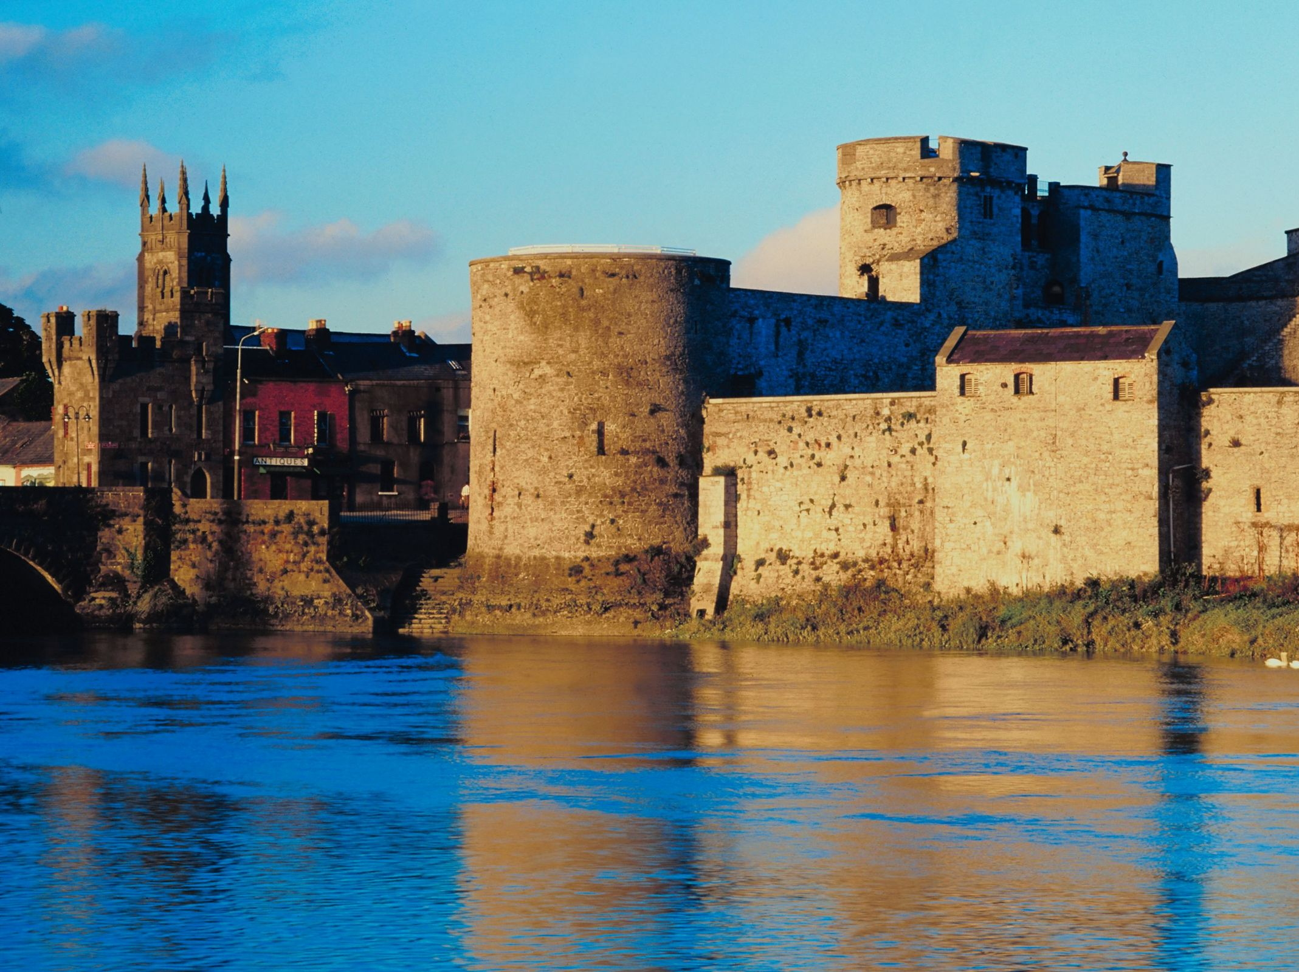
How The Research Competition Works
Each member country selects a winning team for the GTTP Research Award in their country.
The winning school sends two students and their teacher to an international conference at Sophia Antipolis near Nice, France.
At this meeting the winning teams present their research findings and meet students and teachers from all GTTP-member countries.
They also will have the opportunity to meet the GTTP Global Partner Advisory Board members.
For details Click Here.
For guidelines Click Here.
To see past winners Click Here.
For more information for schools based in Ireland contact Natasha Kinsella, GTTP Ireland: natasha.kinsella@hotmail.com

Slide 9
GTTP Sustainability Competition: “Building a Better Place”
In 2017 GTTP and UNWTO sponsored a competition to focus on sustainability, not just in Travel & Tourism, but in our everyday lives.
The competition was open to all GTTP students.
You can visit the competition website here.
Keep an eye on the website for any details on 2018.

Slide 10
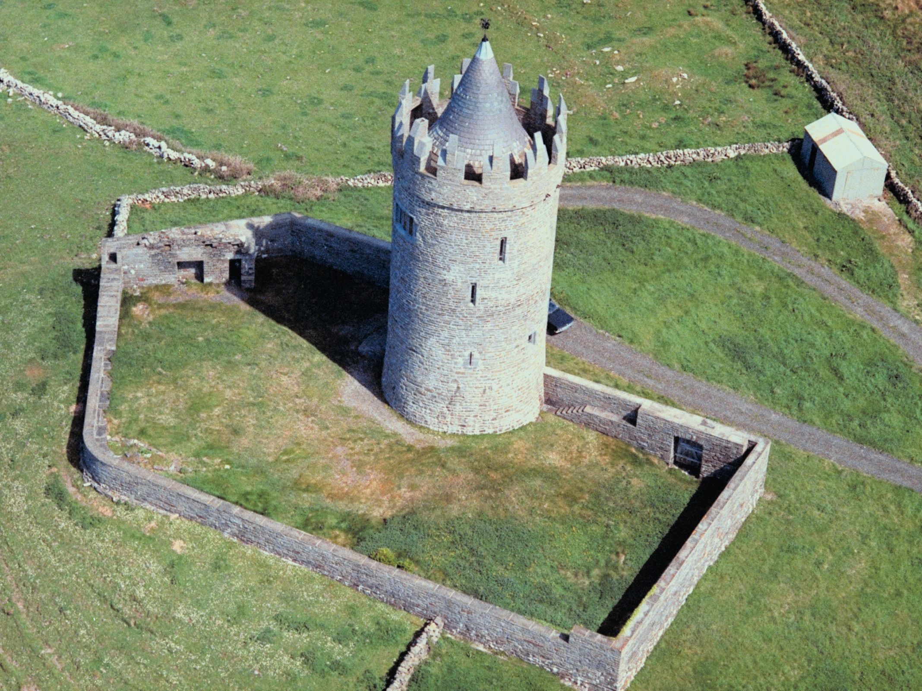
GTTP Student of the Year Country Recognition
The Student of the Year award is given to students who exemplify the qualities important for a career in Travel & Tourism: dedication to her/her studies, the ability to work independently and with team mates, creativity, integrity, a positive attitude and mastery of Passport to the World materials.
Students must be nominated by their teacher to be eligible for this award.
The winning students receive a scholarship specifically for higher education in a Tourism education program.
Students of the year also may have the opportunity to be interviewed for an internship with one of the GTTP Global Partner sponsors.
For more details Click Here.
To see past winners Click Here.

Slide 11
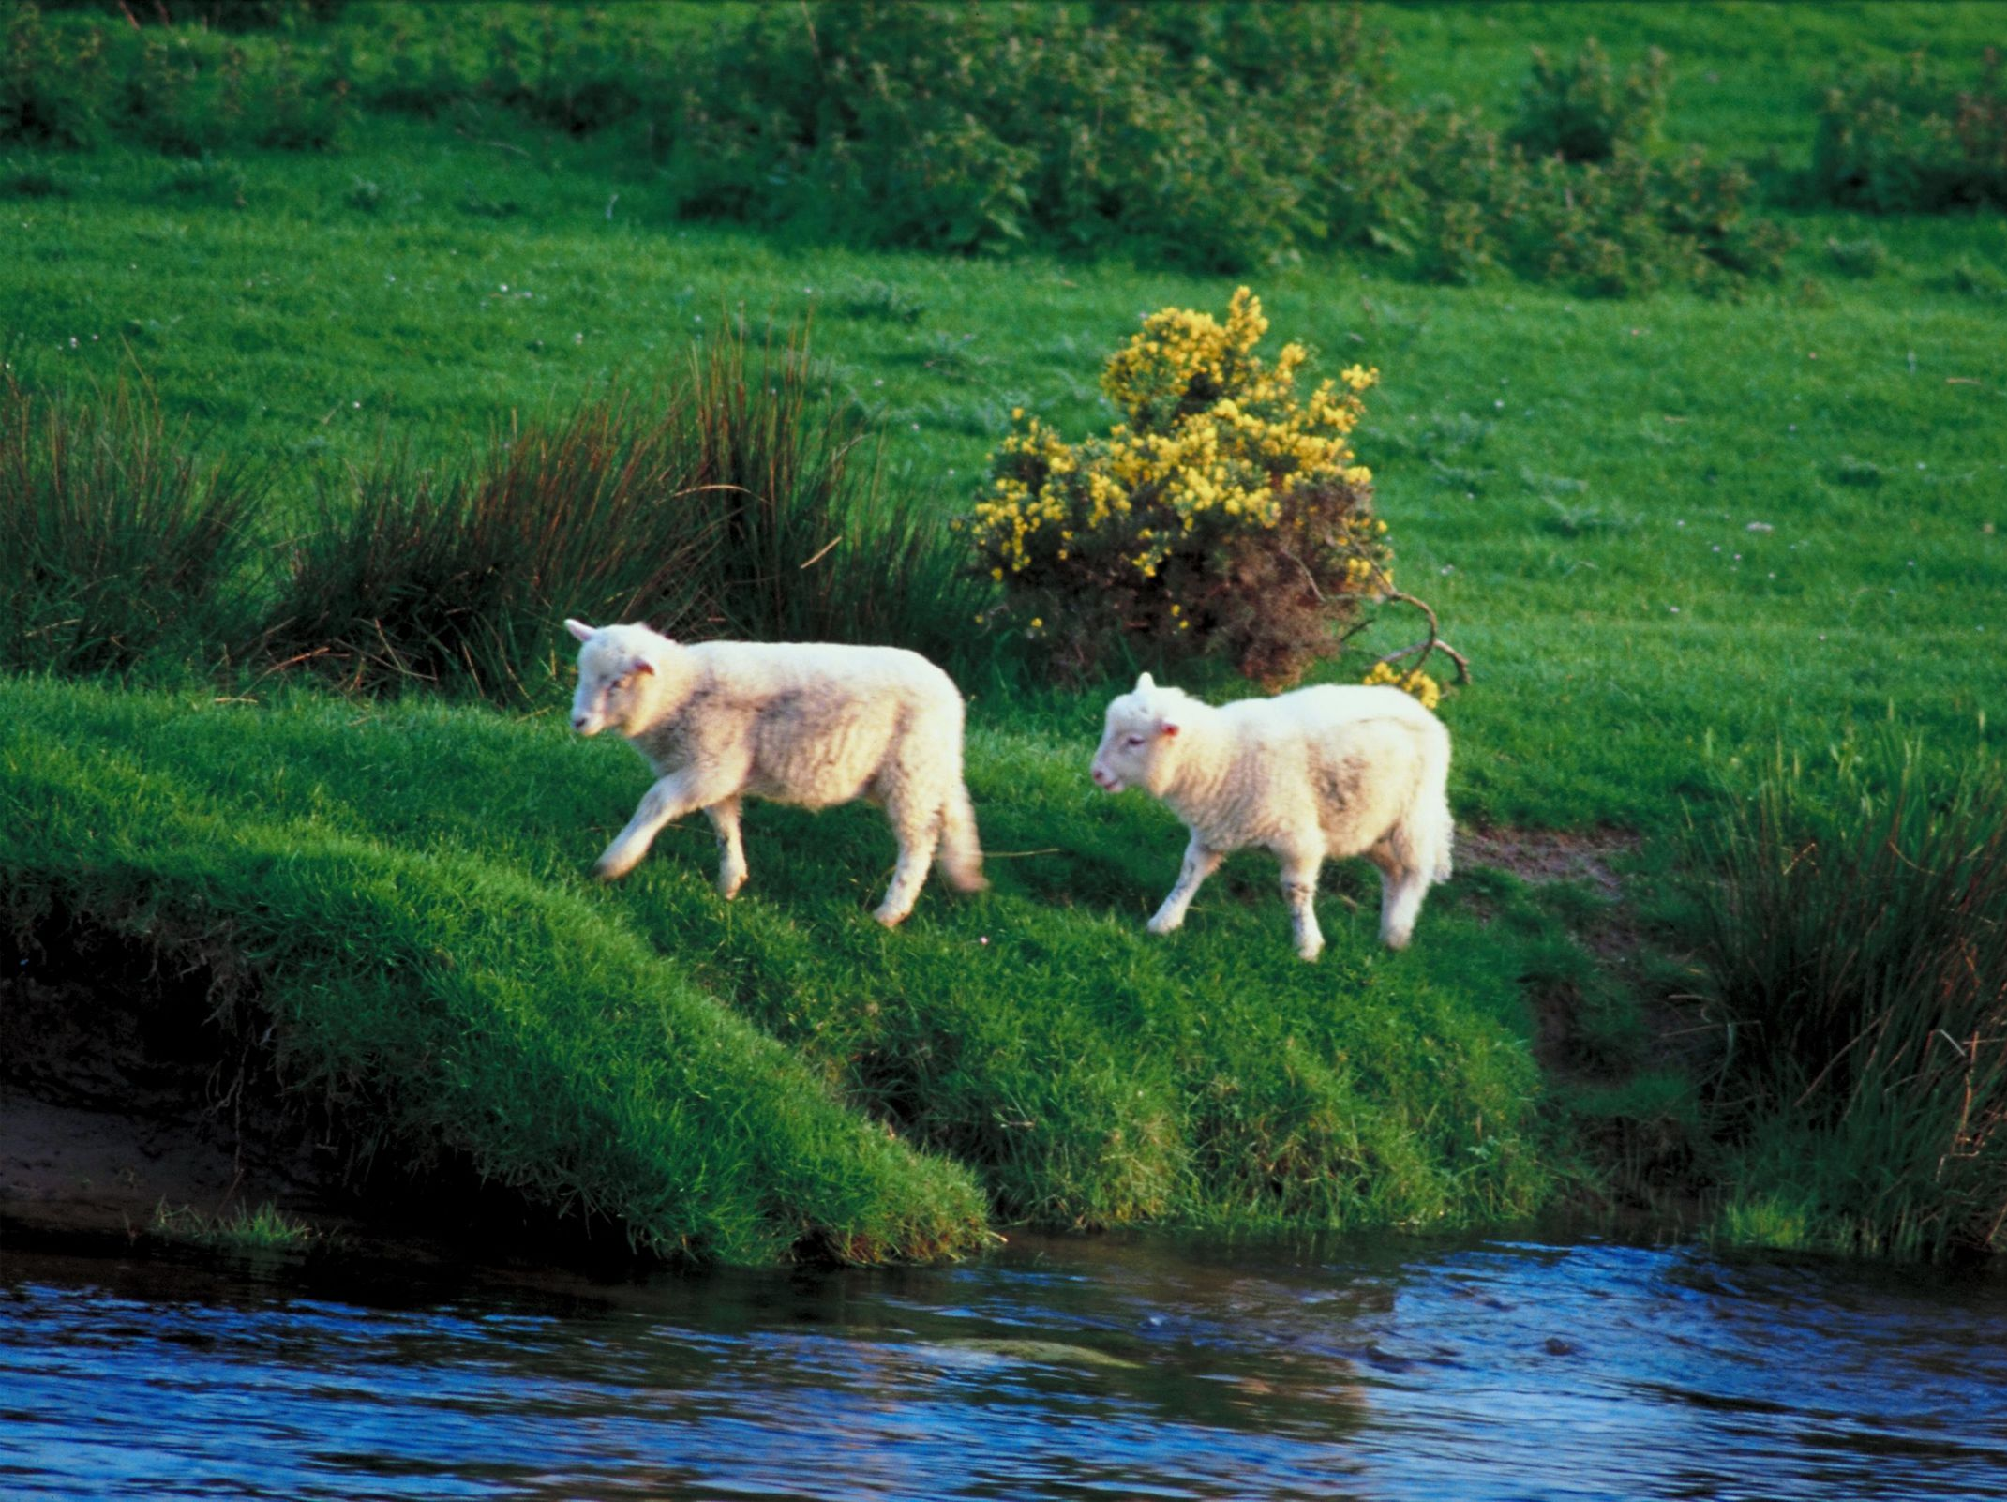
GTTP COMPETITIONS IRELAND
For all queries contact natasha.kinsella@hotmail.com or call 0868377286
Natasha Kinsella – Ireland Director GTTP

